Slide 2




Milestones within the HIV program (2010-2023)
2010
2015
2019
2020
2021
2022
HIV Prevalence- 6.4%
Incidence- 0.31%
Mortality- 53,000
MTCT Rate- 21%
PLHIV- 1,493,165
HIV Infections-71,000
HIV Prevalence- 5.9%
Incidence- 0.27%
Mortality- 35,821
MTCT Rate- 8%
PLHIV- 1,517,707
HIV Infections-77,647
HIV Prevalence- 4.5%
Incidence- 0.11%
Mortality- 20,997
MTCT Rate- 10.8%
PLHIV- 1,508,405
HIV Infections-41,416
HIV Prevalence- 4.3%
Incidence- 0.09%
Mortality- 19,486
MTCT Rate- 9.7%
PLHIV- 1,435,271
HIV Infections-32,027
HIV Prevalence- 4.0%
Incidence- 0.098%
Mortality- 22,373
MTCT Rate- 8.9%
PLHIV- 1,437,267
HIV Infections-34,540
HIV Prevalence- 3.7%
Incidence- 0.059%
Mortality- 18,473
MTCT Rate- 8.6%
PLHIV- 1,377,784
HIV Infections-22,154
Source: HIV Estimates 2023

Slide 3
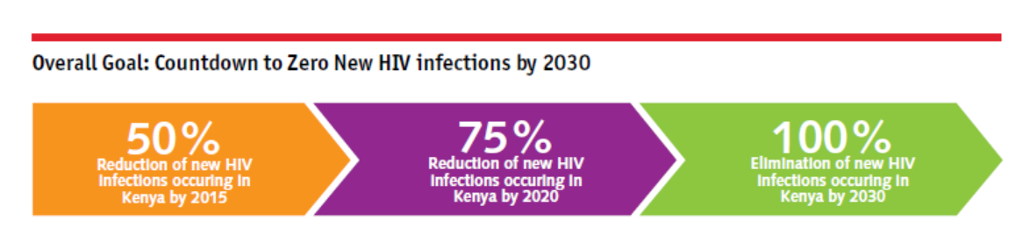
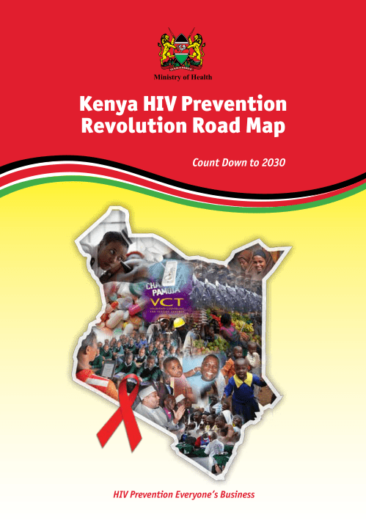


The objectives of this Road Map are to provide guidance for:
Geographical and population prioritization of HIV prevention interventions to optimize reduction of new HIV infections
Scale-up and implementation of combination HIV prevention interventions
Monitoring and tracking of HIV prevention efforts
A Kenya free of HIV Infections, Stigma and AIDS related deaths

Slide 4

The HIV Prevention Acceleration Plan
The HIV Prevention Acceleration Plan 2023–2030 provides guidance for designing the nation’s HIV prevention response. The plan is aligned to the Kenya HIV Prevention Revolution Road Map: Count Down to 2030 and the Kenya AIDS Strategic Framework II (KASF II) 2020/21–2024/25. At the global level, the plan is guided by the Global HIV Prevention Coalition’s HIV Prevention Road Map 2025 and by UNAIDS’ Global AIDS Strategy 2021–2026.
This acceleration plan is guided by the following key principles:
Respect for and promotion of human rights, social justice, equality, and equity in access to HIV and AIDS services
Universal Health Coverage
Inclusion and participation of all stakeholders at national and county levels
People-centred service delivery
Evidence-informed planning, prioritisation, and investments
Multisectoral partnership and accountability

Slide 5
HIV in Kenya
Kenya has made progress in the HIV response
The KASF II commits to reducing new HIV infections in Kenya to 8,000 annual new infections by 2025, and this plan has set targets of fewer than 1,000 adult annual new infections and fewer than 200 child annual new infections by 2030

Slide 6
The process of developing the plan
The country adopted a participatory approach for developing the national HIV prevention acceleration plan. The three-phase process of drafting the plan started with an HIV prevention summit in 2021, which was a review meeting with national- and county-level stakeholders
Phases of the HIV Prevention Acceleration Plan’s development

Slide 7
Objectives

Slide 8
Expected results

Slide 9
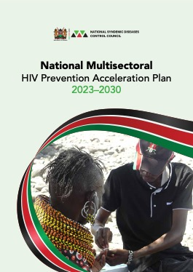
Strategic directions
Based on the lessons learnt and the objectives of this HIV Prevention Acceleration Plan, the following strategies will be adopted:

Slide 10
Strategy 1: Apply a Precision and Differentiated Prevention Approach Based on Current Evidence, Geographic Prioritisation, Subpopulation Groups, and Epidemic Typology
Prioritisation of the counties by potential for impact on HIV incidence
Prioritisation of populations based on vulnerability and risk
Prioritisation of populations based on epidemic typology

Slide 11
Strategy 2: Scale Up Provision of Effective Comprehensive Combination Prevention Interventions, Tailored To Meet the Specific Needs and Contexts of Subpopulations
Combination prevention package

Slide 12
Strategy 3: Strengthen and Expand Community-Centred HIV Prevention Services
Community of practice
Leadership and ownership of affected communities
Community-led monitoring

Slide 13
Strategy 4: Promote Integration of HIV Prevention into Essential Related Services to Improve HIV Outcomes
Multiple layers of integration

Slide 14
Strategy 5: Institute Mechanisms for Rapid Introduction of New HIV Prevention Technologies and Programme Innovations
Emerging HIV prevention technologies

Slide 15
Strategy 6: Develop and Implement Innovative Country Investment Financing Approaches for a Sustainable HIV Prevention Response
External financing for Kenya’s health programmes has significantly declined as Kenya has graduated to a lower middle-income country.
Domestic resource mobilisation efforts to finance gaps left by donors is imperative.
We must secure the gains made so far and scale up the national response to HIV and AIDS.

Slide 16
Strategy 7: Strengthen National, Sub-National Coordination and Management of HIV Response through Multisectoral Collaboration and Accountability of All Stakeholders
The National Multisectoral HIV Prevention Steering Committee
Secretariat for the National HIV Multisectoral Steering Committee
County Multisectoral HIV Coordination Committee

Slide 17
Strategy 8: Adopt Programme Science and Use Data to Enhance HIV Prevention Programme Effectiveness
HIV prevention cascades
The effective programme coverage framework

Slide 18
Strategy 9: Strengthen the HIV Prevention Programme Monitoring and Evaluation System
Development and implementation of a comprehensive HIV prevention monitoring framework
Routine HIV prevention programme monitoring
HIV prevention-related outcome and impact measurement

